Slide 1

PROJECT OBJECTIVE
Strategic Data for Informed Decisions
Our primary objective is to transcend simple data analysis and instead craft a compelling narrative from our customer data. By transforming raw information into actionable insights, we aim to guide the business toward more effective and data-driven decision-making processes.
Bank Customer Segmentation: A Power BI Report
From Data to Story
Gain Valuable Insights
Moving beyond raw numbers to create clear, impactful narratives for business understanding.
Uncovering hidden patterns and trends within our extensive customer dataset.
Empower Business Decisions
Providing the intelligence needed for strategic planning and operational improvements.

Slide 2
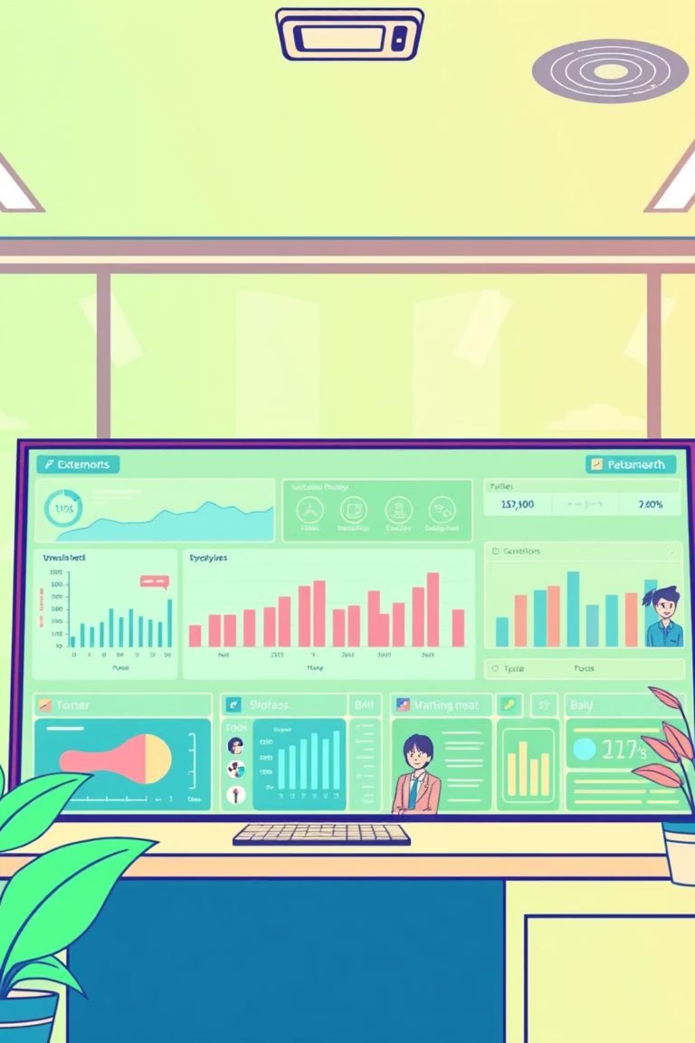
Introduction
Good afternoon. As your BI developer, I am pleased to present this comprehensive report on bank customer segmentation. This analysis leverages key customer data to reveal actionable insights, empowering our business to make more informed and strategic decisions.

Slide 3


Comprehensive Data Overview
Our analysis is built upon a robust dataset encompassing vital customer demographics and detailed transaction records. This dual perspective allows for a holistic understanding of our customer base and their financial behaviors.
Customer Demographics
Transaction Details
Customer ID
Transaction ID
Date of Birth (DOB)
Transaction Date & Time
Gender
Transaction Amount (INR)
Location
Account Balance

Slide 4







Interactive Visual Elements
To ensure an interactive and deeply insightful report, we have integrated a diverse array of visual elements. These tools enable you to explore data, uncover trends, and drill down into specific areas of interest with ease.
KPI Cards
Bar & Column Charts
Snapshot key metrics for quick understanding.
Visualize distributions and comparisons effectively.
Scatter Plots
Waterfall & Funnel
Identify relationships and correlations between variables.
Track cumulative effects and process stages.
Slicers & Filters
Detailed Tables
Enable dynamic, self-service data exploration.
Provide granular data for in-depth review.

Slide 5




Three Core Areas of Insight
Our investigation is structured into three fundamental analytical areas, each designed to answer specific questions critical to understanding our customer base and optimizing our business strategies.
Customer Demographics
Transactional Analysis
Customer Segmentation
Who are our customers?
How do they interact with us?
How can we tailor our approach?

Slide 6
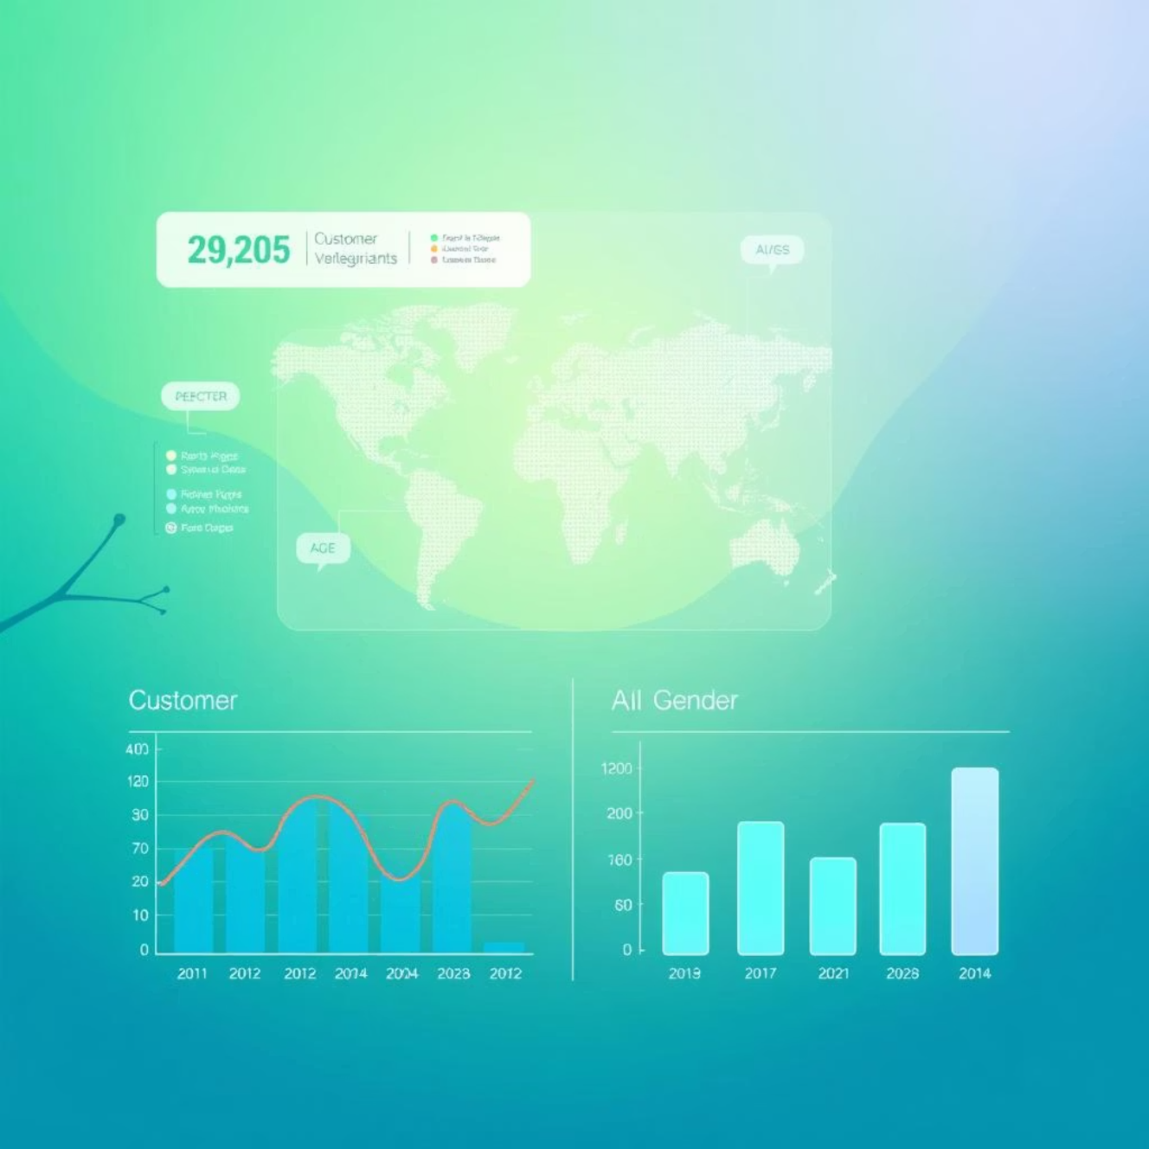
Customer Demographics Analysis
This section provides a granular understanding of our customer base, revealing crucial insights into their characteristics and distribution across various dimensions. Understanding these factors is key to targeted outreach.
Key Demographic Questions:
Total Customers: How many individuals comprise our customer base?
Average Age: What is the typical age of our customers?
Age Group Distribution: How are customers spread across different age brackets?
Location Concentration: Which geographical locations house the most customers?
Gender & Age Variation: How does gender distribution change across various age groups?
A detailed table showcasing customer gender, location, and age is available for in-depth exploration.

Slide 7
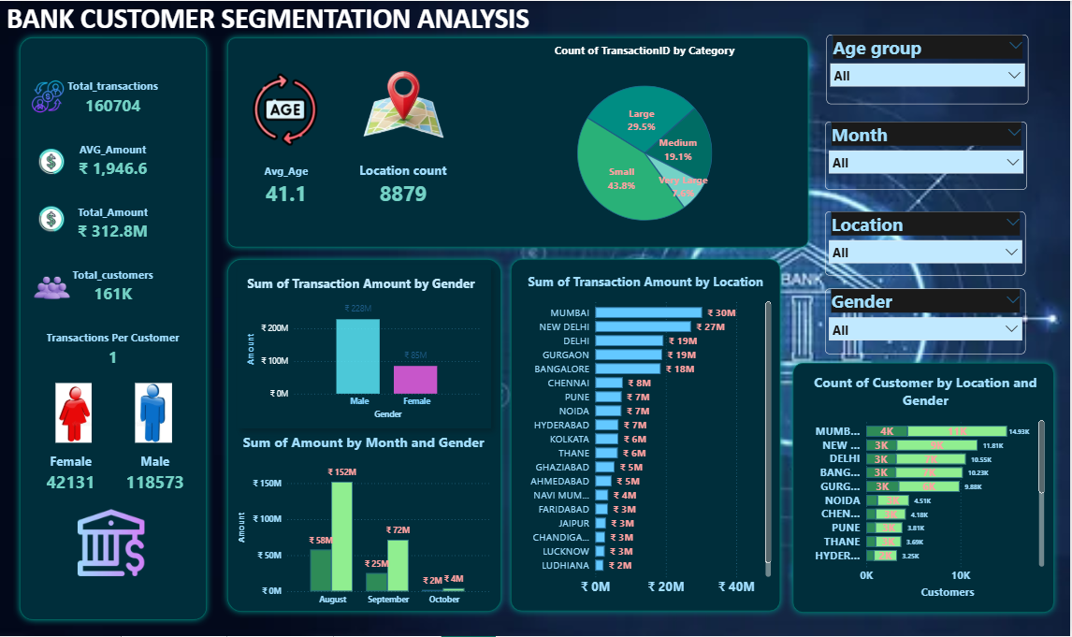

Slide 8


Transactional Analysis
This segment of the report thoroughly examines customer behavior through their transactional data. By dissecting transaction patterns, we gain clarity on engagement levels and identify high-value interactions.
Total & Average Value
Top Branches & Customers
Understand overall financial activity and typical transaction size.
Identify high-performing branches and our most active patrons.
Activity by Amount & Time
Analyze peak transaction periods and typical transaction values.
Interactive filters are available to enable deeper exploration into specific transaction types or timeframes.

Slide 9
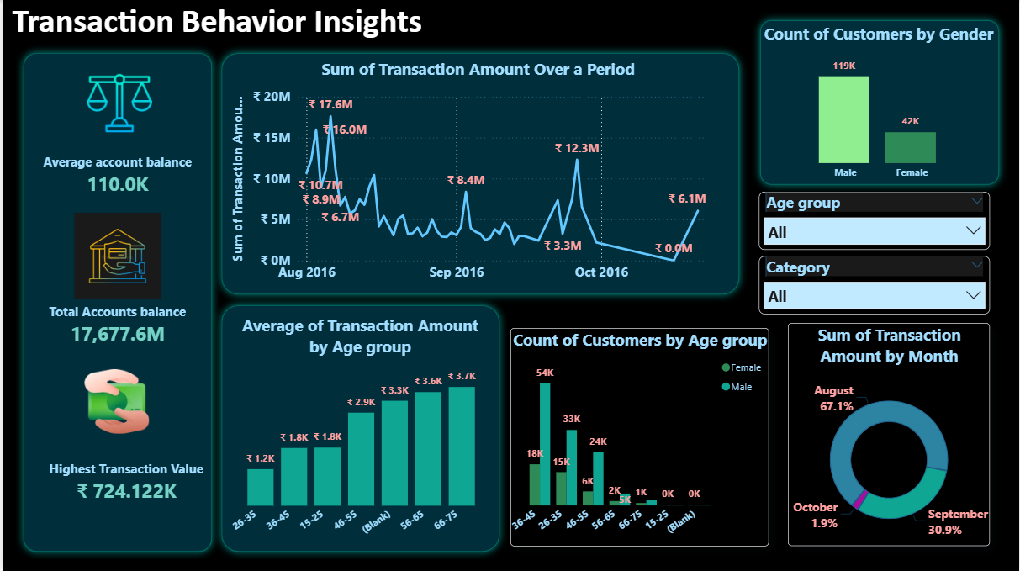

Slide 10









Profitability & Risk Indicators
Our segmentation model categorizes customers into distinct groups, allowing us to tailor marketing efforts, product offerings, and service strategies for maximum impact and relevance.
Segment Identification
Revenue Comparison
Loyal, New, and Lost Customers
Total Revenue Across Segments
Engagement Insights
Value Metrics
Highest Transaction Frequency
Avg. Revenue Per Customer

Slide 11
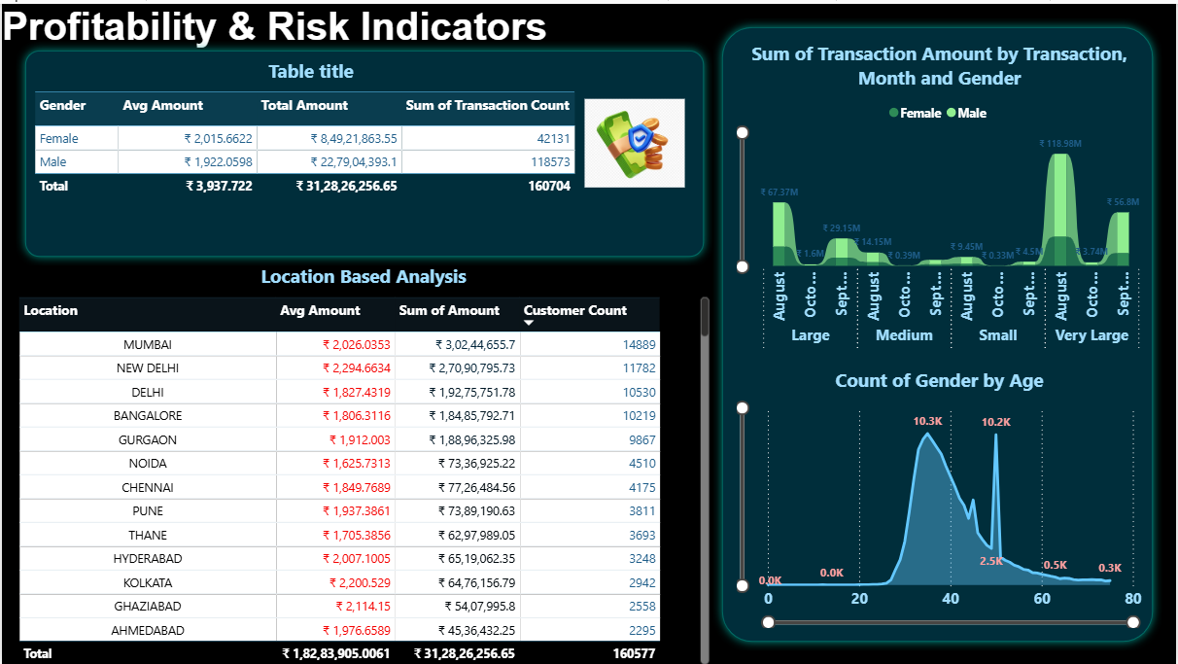

Slide 12

CONCLUSION
This report serves as a robust foundation for gaining a profound understanding of our customers and their dynamic behaviors. It is meticulously designed to be interactive, empowering you to delve deeper into the data and uncover tailored insights that matter most to your role.
Interactive Exploration: Leverage built-in filters and drill-down capabilities to answer your specific questions.
Data-Driven Story: Transform raw data into clear, actionable narratives that support strategic initiatives.
Unleash Potential: Identify new opportunities for growth, improved customer engagement, and operational efficiency.

Slide 13


